Slide 1
Communication in Pediatric Nursing
Communication in Pediatric Context
Third Stage
Dr. Moustafa Ali Alshammari
Pediatric Nursing

Slide 2
LEARNING OUTCOMES
After completing this lecture, you will be able to:
Define communication and explain why it is especially critical in pediatric nursing (for safety, trust, adherence).
Choose appropriate communication strategies when interviewing parents and children (by age).
Apply teach-back to pediatric families to ensure understanding.
Use developmentally tailored language, nonverbal cues, and distraction in pediatric procedures.
Reflect critically on barriers unique to pediatric settings and propose evidence-based mitigation.

Slide 3
Communication in Pediatric Context
Definition: Communication is the exchange of meanings among people via a shared system of symbols (words, gestures, expressions).
It is both talking and listening (i.e., sending and receiving).Effective communication requires not just sending, but verifying that the receiver understood the meaning intended.

Slide 4
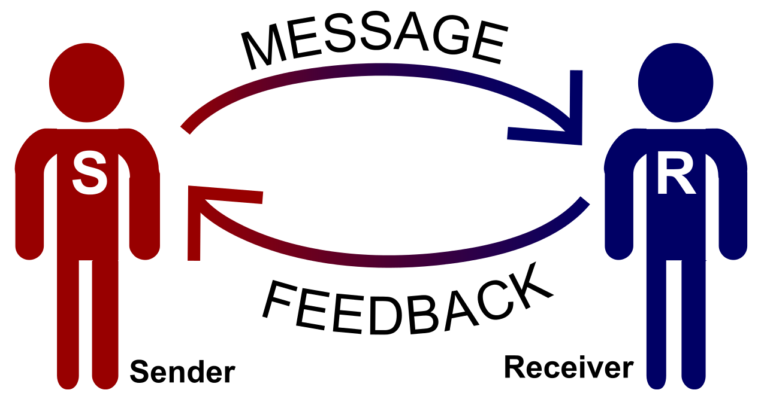
Components of the Communication Process
Sender ( the nurse, or parent)
Message (content, clarity)
Channel (verbal, nonverbal, visual aids)
Receiver(s) (child, parent)
Feedback (verbal or nonverbal responses)
Context (setting, developmental level, cultural background
context

Slide 5
Types of Communication: Verbal & Nonverbal
1. Verbal Communication
Verbal communication uses words (spoken or sometimes written). The effectiveness depends on clarity, relevance, timing, tone, pacing, and avoiding jargon.

Slide 6
Types of Communication: Verbal & Nonverbal
Characteristics of effective verbal communication:
Brief, clear, well-timed
Appropriate pacing — not too fast, not so slow that attention is lost
Avoid medical jargon, especially when speaking with children or caregivers
Repeat key points to reinforce essential messages
Check understanding (ask for feedback)
Warmth, interest, empathy conveyed in voice and phrasing
Avoid distractions, yes/no overuse, personal bias
Don’t monopolize conversation

Slide 7
Nonverbal Communication in Pediatrics
Nonverbal communication includes everything other than the words used: gestures, facial expressions, posture, eye contact, touch, spatial distance, timing, and tone. Many theorists believe that a large portion of meaning is carried nonverbally.

Slide 8
Nonverbal Communication in Pediatrics
Reasons nonverbal is powerful:
When verbal and nonverbal conflict, listeners tend to believe nonverbal cues.
Nonverbal cues often convey emotions, attitudes, and relational messages more than the words themselves.
Nonverbal is continuous, often subconscious, and cross-cultural (though interpretations vary)

Slide 9
Elements / dimensions of nonverbal communication:
Gestures (emphasizing, pointing)
Facial expressions (smile, frown, raised eyebrows)
Timing / hesitation / pauses
Touch (appropriate, comforting)
Spatial relationships / proxemics (how close you stand)
Appearance (clothing, grooming)
Eye contact
Body posture (leaning forward, slouching, turned away)

Slide 10
Scenario:
A nurse enters a child’s room to explain a procedure. The nurse sits at the child’s eye level (nonverbal: reduces intimidation), uses a soft tone, and smiles gently. The nurse says, “I’m going to check your breathing for a few seconds.” The child nods. The mother asks, “Will it hurt?” The nurse pauses, touches the child’s shoulder (if acceptable), and answers truthfully, “You may feel a little pinch, but it will be fast, and I’ll be right here with you.” Because nonverbal and verbal align (gentle posture, reassurance), the child and parent are calmer.

Slide 11
Developmental Level Communication Principles
Infants (0–12 months)
Principles:
Allow the infant time to warm up to strangers.
Respond to the infant’s cries in a timely manner.
Use “motherese” (infant-directed speech), a soothing and calm voice.
Talk to the infant directly (even though caregiver is present).

Slide 12
Developmental Level Communication Principles
Toddlers (1–3 years)
Principles:
Approach at eye level if possible.
Approach the toddler carefully; the child may be fearful.
Integrate the toddler’s words for familiar objects or activities into care.
Prepare for procedures right before they are carried out.
Use dolls, storytelling, and picture books in conversations.
Stand at eye level (repeated to emphasize).

Slide 13
Developmental Level Communication Principles
Preschoolers (3–5 years)
Principles:
Allow choices when appropriate.
Use play, storytelling, puppets, and third parties.
Speak honestly, use simple language, and be concise.
Prepare for procedures 1 hour or less before they occur.

Slide 14
Developmental Level Communication Principles
School-Age Children (6–12 years)
Principles:
Use books, diagrams, and videos to prepare for procedures.
Prepare for procedures several days in advance.
Allow honest expression of feelings and adequate time for questions.

Slide 15
Developmental Level Communication Principles
Adolescents (13–18 years)
Principles:
Prepare up to 1 week prior to experiences.
Respect the adolescent’s need for privacy.
Use appropriate medical terminology (but explain it).
Use creative methods to explain experiences and procedures.
Respect the adolescent’s right to refuse treatment (within legal/ethical limits).

Slide 16
Thank you

